Slide 1
Integrating PowerApps with External Systems
Notes:
This module examines how to integrate data from external systems and on-premises data sources. Student will learn to build flows with the HTTP action to call external web services and to parse JSON from an HTTP response. The module also explains how to build flows with HTTP triggers which can be used to process forms and surveys created using Microsoft Forms. The module explains the purpose of custom connectors and examines real-world scenarios in which they are required. The module introduces students to swagger file definitions and demonstrates using the PowerApps portal to create a custom connector to communicate with a custom web service. The module demonstrates creating custom connectors which can handle OAuth2-style authentication with web services protected by Azure AD such as the Microsoft Graph API and the Power BI Service API. The module concludes with a discussion of how to install and configure an On-premises Data Gateway which makes it possible for canvas apps and flows to read and write data from on-premises data sources such as SQL Server and local SharePoint farms.

Slide 2
Agenda
Calling External Services using HTTP Actions
Executing Child Flows from a Parent Flow
Creating and Testing Custom Connector
Configuring a Custom Connector to use OAuth

Slide 3
HTTP Request and Response
HTTP Request
URL
Verb (e.g. GET, POST, PUT, PATCH, etc)
Headers
Body
HTTP Response
Status code
Headers
Body
Client
HTTP Request
Web Service
HTTP Response

Slide 4
Working With REST-based Web Service
Calling REST-based web service involve creating structured URLs
http://subliminalsystems.com/api/Customers/?$select=LastName,FirstName,CustomerId
REST-based URL structured into several parts
http://subliminalsystems.com/api/
Customers/
?
$select=LastName,FirstName,CustomerId
Web Service Base URL
Resource
Query String Parameters

Slide 5
OData Query String Parameters
Many web services support OData
OData is a REST-based specification for CRUD operations
OData defines standard query string parameters
Commonly-used OData query string parameters
$select – allows you to select which properties are returned
$filter – allows you to filter rows returned in result
$orderby – allows you to sort rows in result
$top – allows you to specify how many rows should be returned
$skip – allows you to skip over rows that are not needed
$expand – allows you to retrieve more data in one round trip

Slide 6
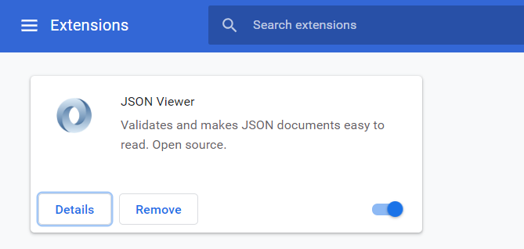
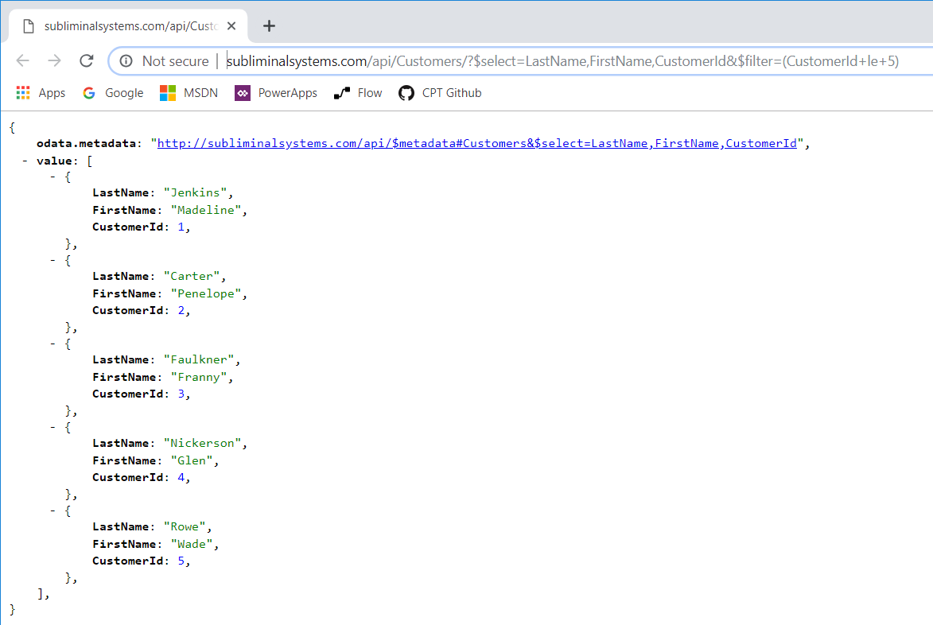
Using the JSON Viewer Chrome Extension
Install the JSON Viewer extension
Now you can inspect JSON in the browser

Slide 7
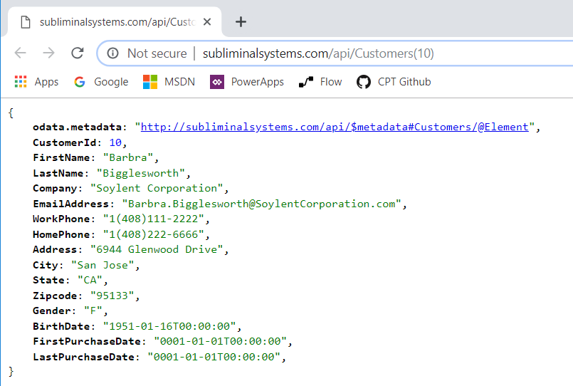
Retrieving a Single OData Instance

Slide 8
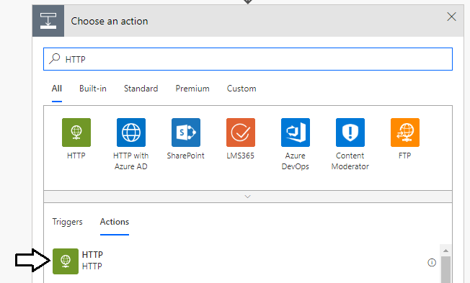
Using the HTTP Action

Slide 9
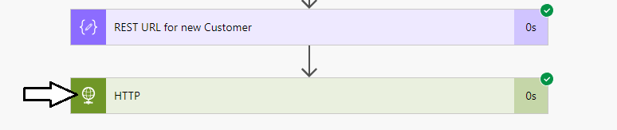
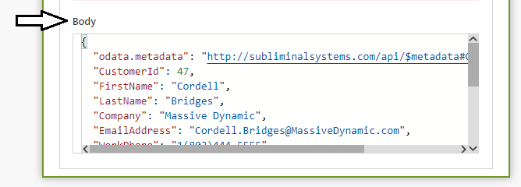
Inspecting the body of the HTTP Response

Slide 10
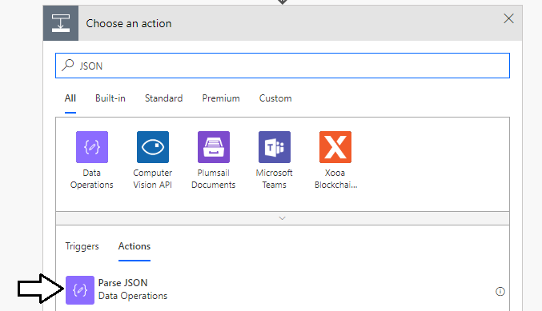
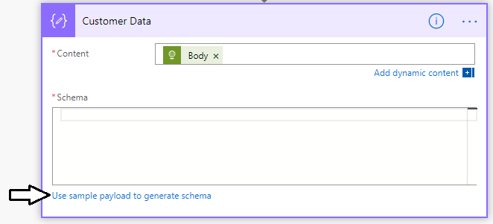
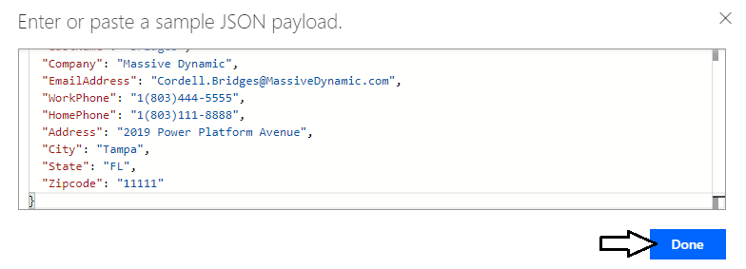
Parsing JSON

Slide 11
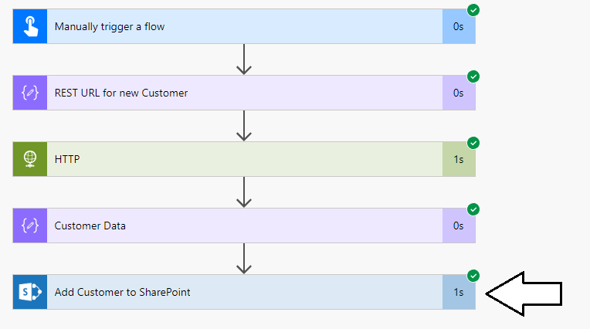
Adding a New Item to a SharePoint List

Slide 12
Calling an External Web Service with the HTTP Action

Slide 13
Agenda
Calling External Services using HTTP Actions
Executing Child Flows from a Parent Flow
Creating and Testing Custom Connector
Configuring a Custom Connector to use OAuth

Slide 14
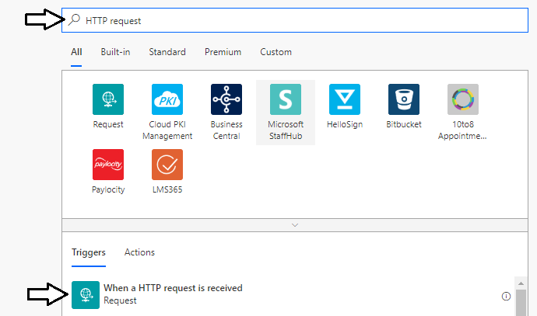
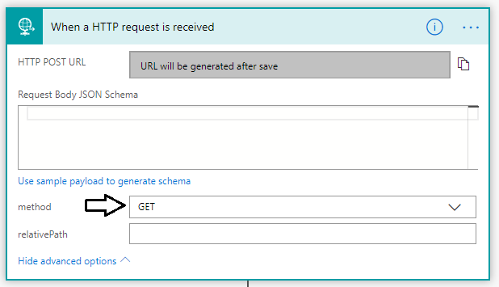
Creating the Child Flow
Child flow creating with HTTP trigger
Select an HTTP operation (e.g. GET, POST, PUT, DELET, PATCH, etc.)

Slide 15
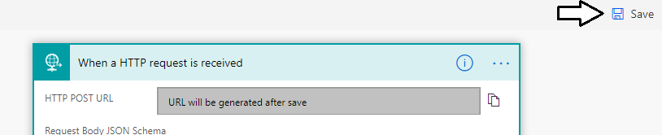
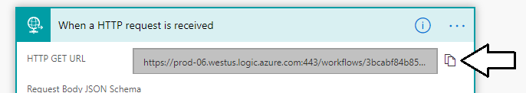


Discovering the URL for an HTTP Trigger
HTTP POST URL is not generated until you first save the flow
After saving the flow you can copy the HTTP POST URL
Copy and paste the URL into Notepad
Try executing the flow by adding the URL into address bar in browser

Slide 16
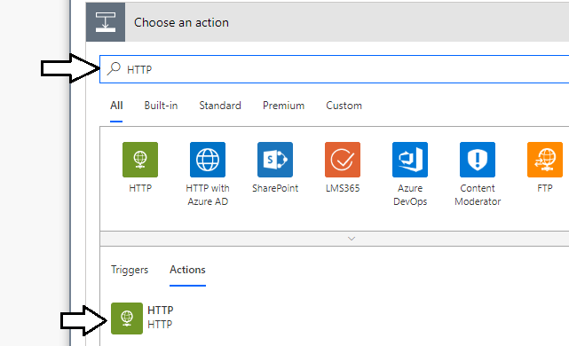
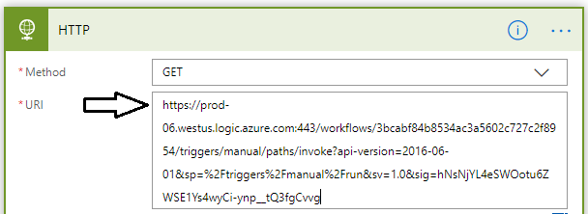
Parent Flow
Parent flow uses HTTP action to execute child flow
Set Method parameter to Get and paste in URL for child flow

Slide 17
Calling a Child Flow from a Parent Flow

Slide 18
Agenda
Calling External Services using HTTP Actions
Executing Child Flows from a Parent Flow
Creating and Testing Custom Connector
Configuring a Custom Connector to use OAuth

Slide 19
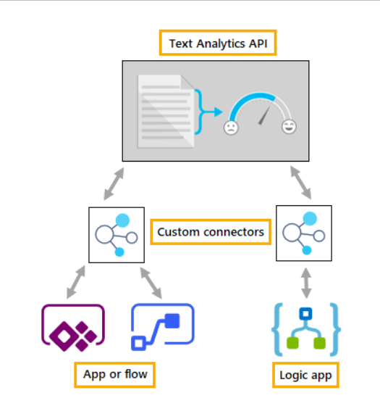
Standard Connectors vs Custom Connectors
PowerApps Supports two types of connectors
Standard connectors supplied out-of-box and vetted by Microsoft
Custom connectors created by organizations for their own use
Notes:
PowerApps supports both standard connectors and custom connectors. The difference is that Microsoft provides standard connectors out-of-the-box as part of the PowerApps platform. If you're connecting to a data source that PowerApps supports with a standard connector, you should use that connector. If you need to connect to a datasource for which Microsoft does not provided a standard connector, you can create a custom connector to integrate the data from that datasource.
Many connectors are designed to work with tabular datasources such as tables in Excel workbooks, tables in SQL Server and lists in SharePoint. With a tabular-based connector, data can be modeled as a table with rows and columns. PowerApps provides its functions for tabular datasources as Patch, Collect and Update which you can call to interact with data in an underlying table. You should also keep in mind that tabular datasources make it easy to use data binding with Gallery controls and Form controls.
PowerApps also supports function-based connectors to interact with datasources that do not fit within the tabular connector model. For example, there are connectors that connect to SaaS services such as Office 365, Twitter and Facebook. When working with function-based connectors, PowerApps is able to move data back and forth between an app and a datasource by executing web service calls against the external Saas service. You can still use these types of connectors to bind data to galleries and forms, but it usually requires a little more work. That’s because you must typically cache the data returned from a function-based connector into a variable or collection in order to bind the data to a gallery or a form.

Slide 20
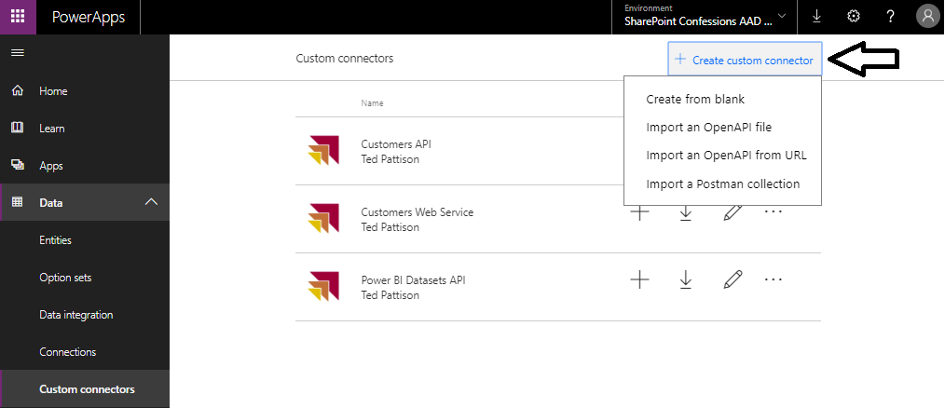
Creating a New Custom Connector

Slide 21
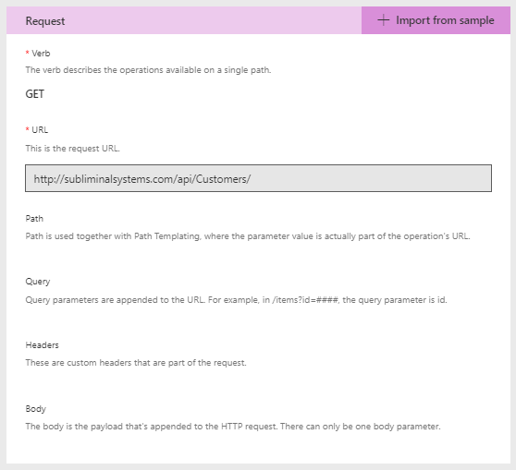
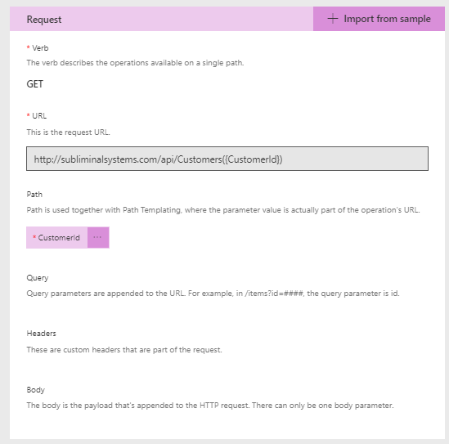
Defining Requests

Slide 22
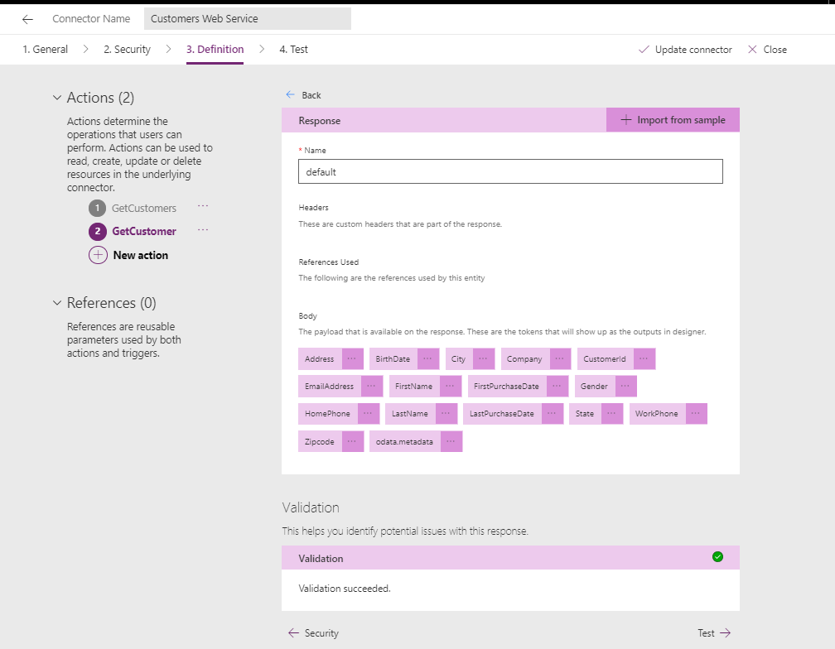
Defining the Response

Slide 23
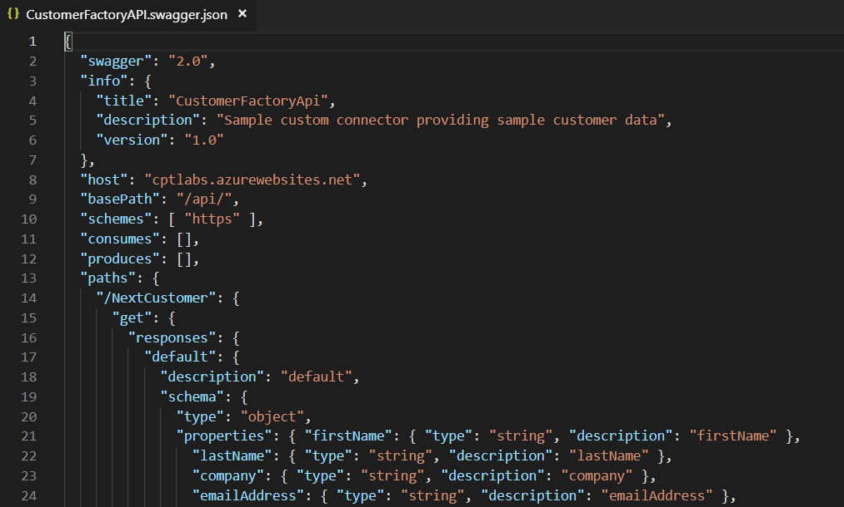
OpenAPI Specification and Swagger
OpenAPI specification (OAS)
Community-driven open specification
Defines standard interface description for REST APIs
allows humans and computers to discover web service API
OpenAPI Specification removes guesswork in calling a service.
API description defined using JSON

Slide 24
Creating a Simple Custom Connector

Slide 25
Agenda
Calling External Services using HTTP Actions
Executing Child Flows from a Parent Flow
Creating and Testing Custom Connector
Configuring a Custom Connector to use OAuth

Slide 26
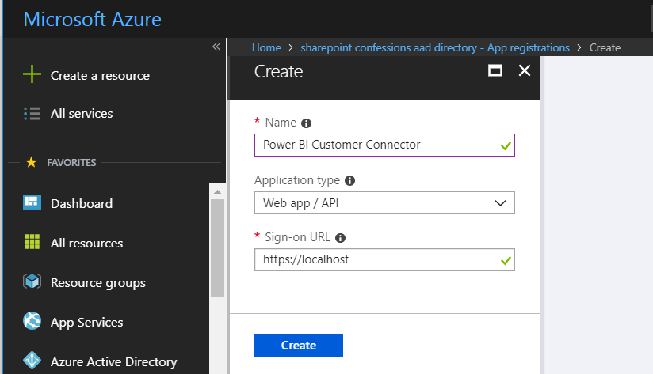
Creating an Azure AD Application

Slide 27
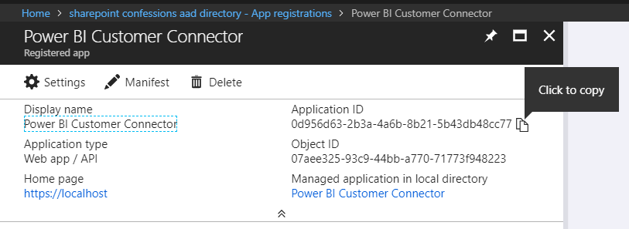
Application ID (aka Client ID)

Slide 28
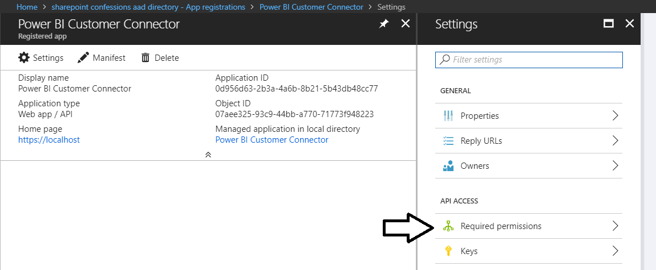
Configuring Permissions

Slide 29
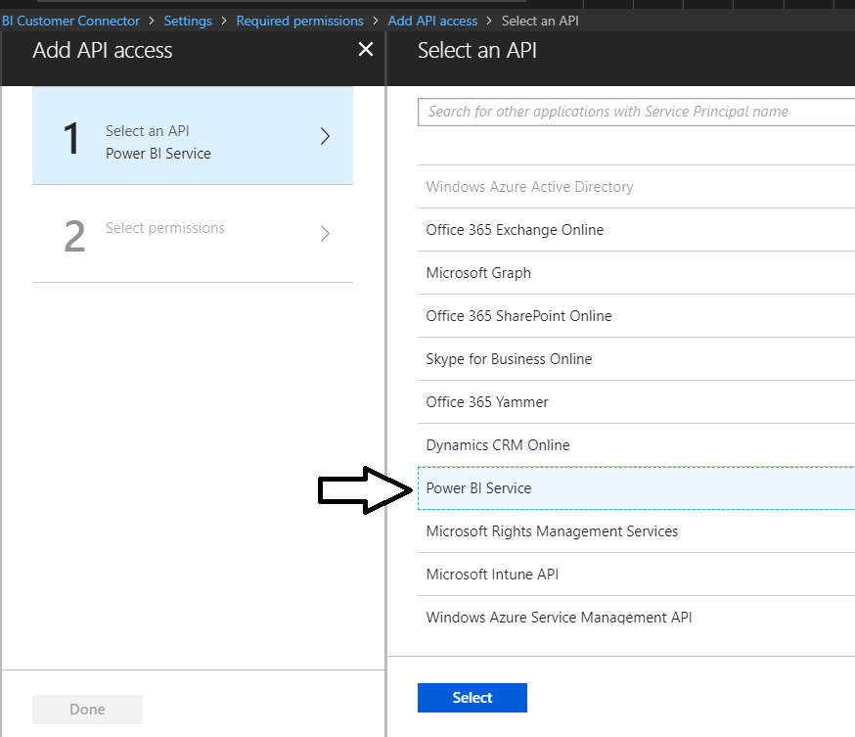
Select the Power BI Service for the API

Slide 30
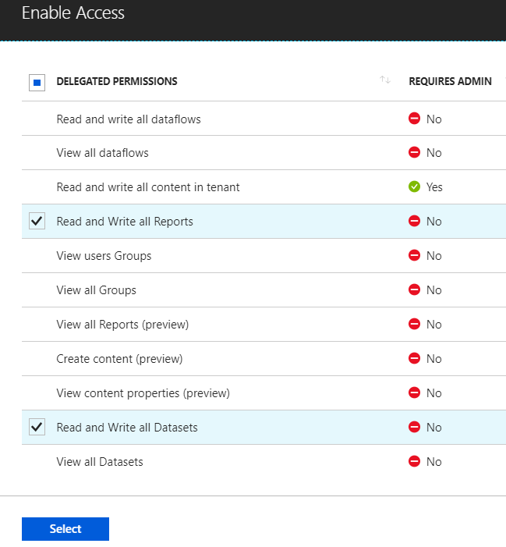
Select the Required Permissions

Slide 31
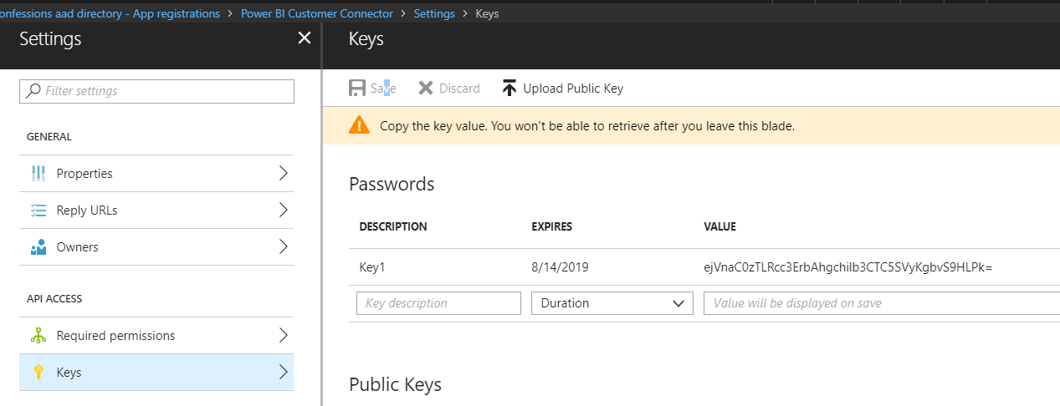
Generating a Key Secret

Slide 32
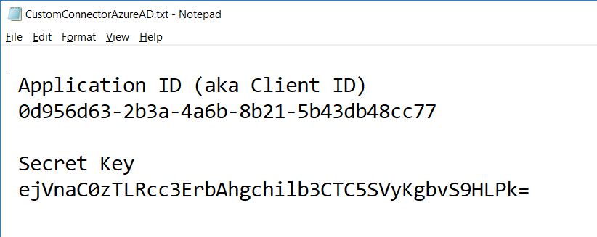
Data Required to Create Custom Connector

Slide 33
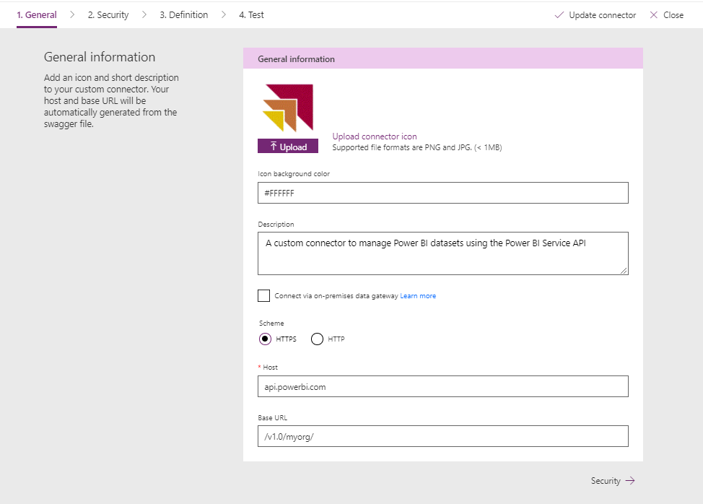
Creating the New Custom Connector

Slide 34
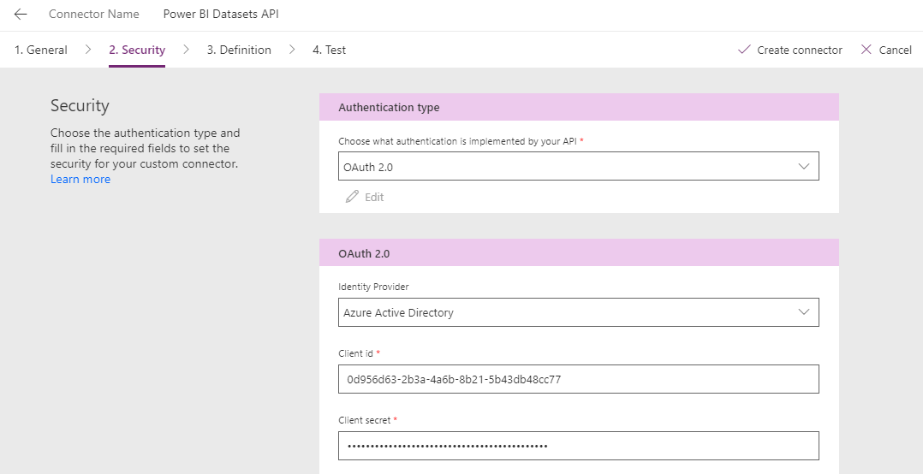
Configuring the Client Id and Client Secret

Slide 35
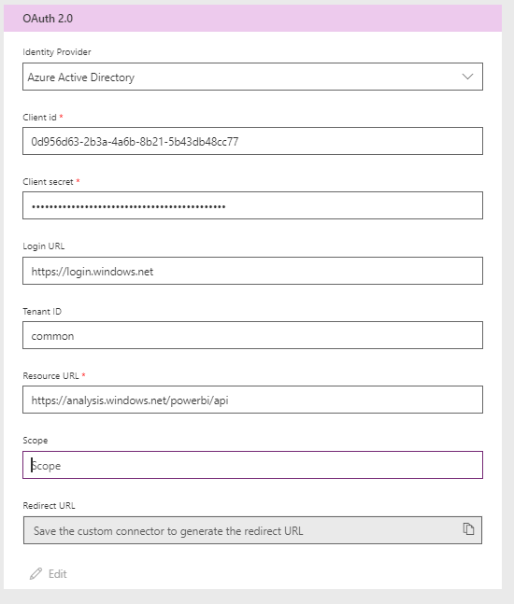
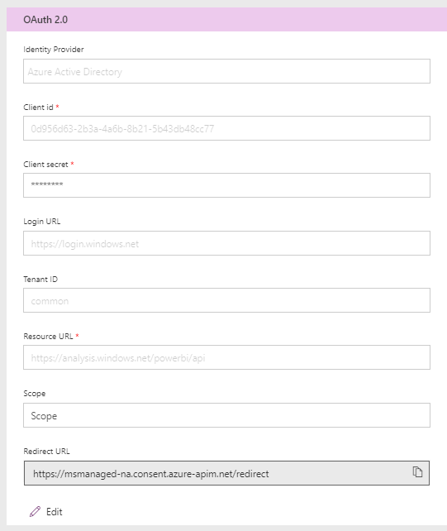
What About the Redirect URL?

Slide 36
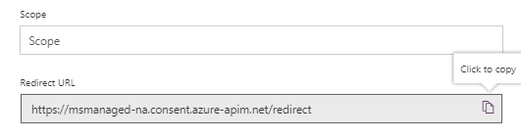
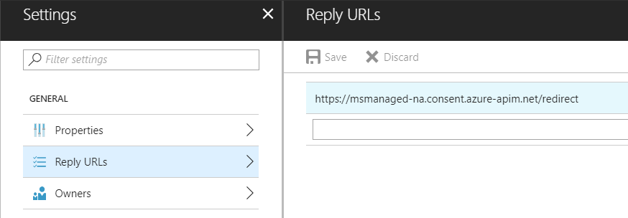
Adding the Redirect URL back in Azure AD

Slide 37
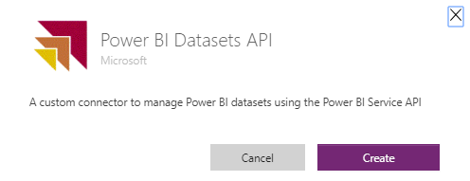
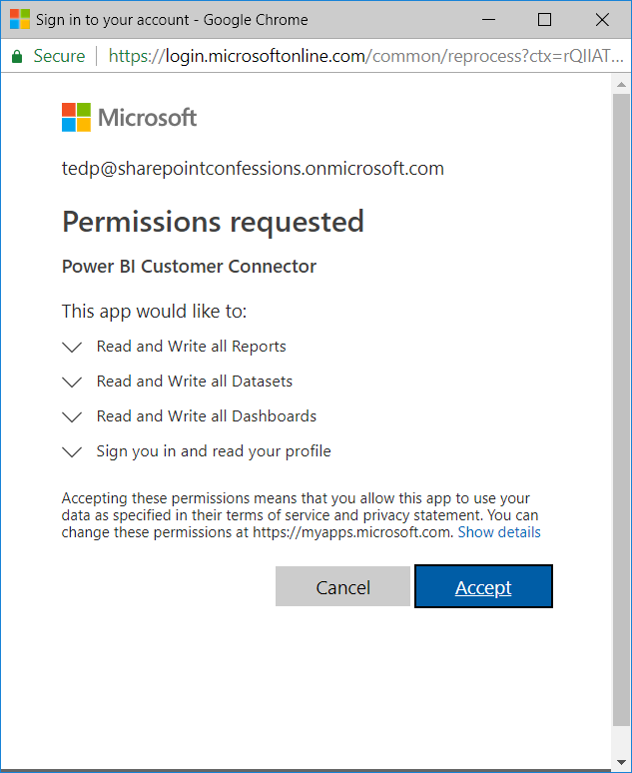
Creating a New Connection

Slide 38
Summary
Calling External Services using HTTP Actions
Executing Child Flows from a Parent Flow
Creating and Testing Custom Connector
Configuring a Custom Connector to use OAuth

